Slide 1
Dancing with Neutrinos
Saturday Morning Physics
Tammy Walton
Fermilab
Jan. 28, 2017

Slide 2
Outline
Discovering the Neutrino
The Mysteries of Neutrinos
Understanding the Behaviors of Neutrinos
Outlook

Slide 3


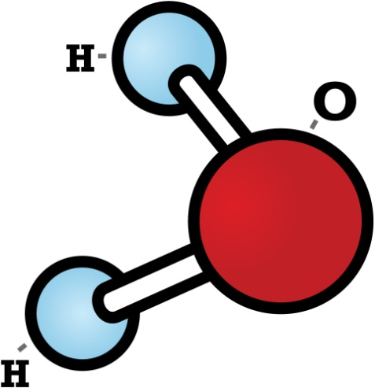
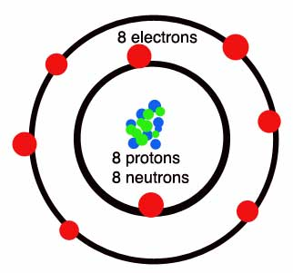
Everything is Composed of Particles!
Hydrogen
Oxygen
quarks
nucleus
Hydrogen

Slide 4
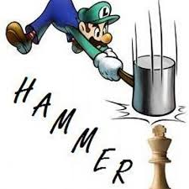
Elementary Particles
Leptons
What does elementary mean?
e
electron
e
Quarks
u
e
up
d
down

Slide 5
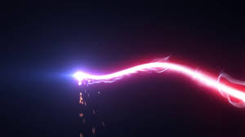
Elementary Particles
Leptons
A particle physicist’s hammer
e
Beam of particles
electron
Quarks
u
up
d
down

Slide 6
Elementary Particles
Leptons
e
^{μ}
^{τ}
electron
muon
tau
1ST GENERATION
2ND GENERATION
3RD GENERATION
u
c
t
up
charm
top
Quarks
d
s
b
down
strange
bottom

Slide 7
Elementary Particles
Leptons
The difference between the generations is the MASS!
e
^{μ}
^{τ}
electron
muon
tau
Quarks
u
c
t
up
charm
top
d
s
b
down
strange
bottom

Slide 8
The Fundamental Forces of the Universe Influence the Behavior of Particles!
e -
e +
e +
e-
The electromagnetic force
Acts upon electrically charged particles
Keeps the electrons bound and orbiting around the atomic nucleus

Slide 9

The Fundamental Forces of the Universe Influence the Behavior of Particles!
Thanks to the electromagnetic force, we can’t walk through walls!
Well, unless you have the X-Gene ☺

Slide 10
The Fundamental Forces of the Universe Influence the Behavior of Particles!
neutron
d
u
d
u
proton
d
u
The strong nuclear force
Holds the nucleus together
Range of the force is 0.000000000000001 meters

Slide 11
Everything is Composed of Elementary Particles!
AND
Nature Can Produce Particles!!!

Slide 12
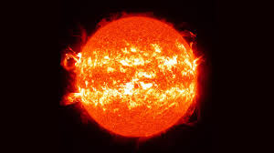
The sun is an ultimate nuclear fusion reactor!
Nuclear Fusion
p
p
NEUTRINOS
p
n
e
ν

Slide 13
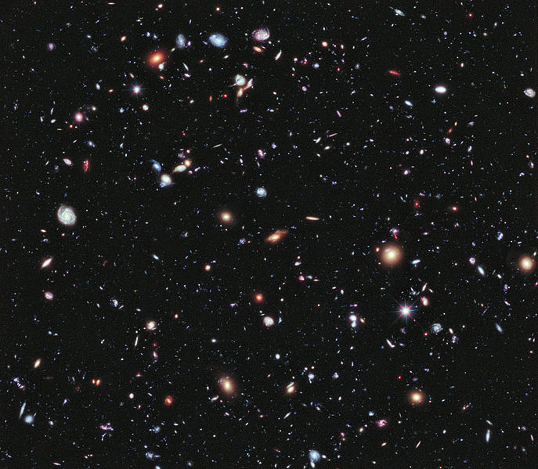
Neutrinos emitted from the
Sun, other stars, and
including the
BIG BANG
are traveling through out
SPACE!!

Slide 14


Millions and millions and millions of neutrinos are also passing through
YOU
at this very MOMENT!

Slide 15
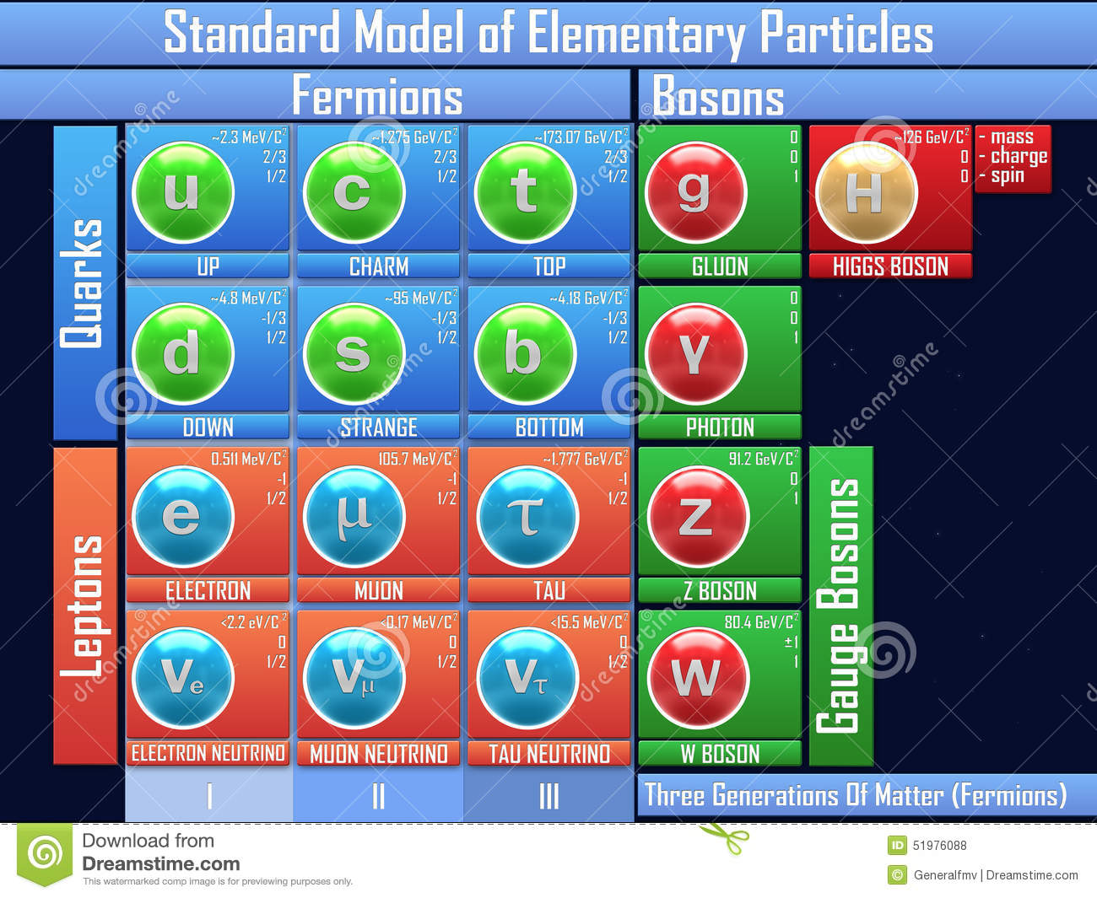
The Complete Picture
We covered this in 5 minutes.
Particles
Forces
Will not talk about The God particle.
This lecture focuses on this section of the picture.

Slide 16
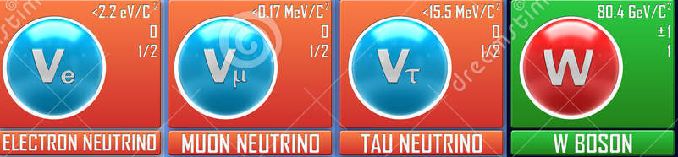
What are neutrinos?
What is the Weak Nuclear force that influences the nature of neutrinos?
Why are neutrinos SO important?

Slide 17
The Discovery of the Neutrino

Slide 18
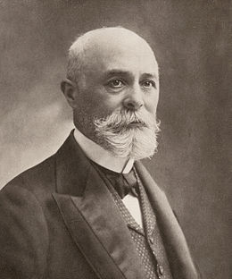
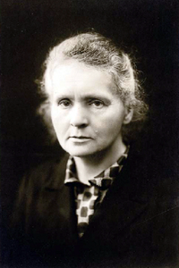
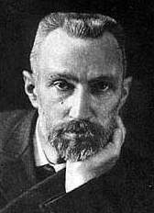
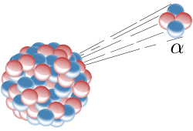
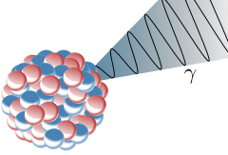
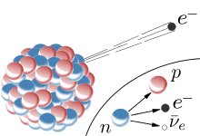
Antoine Henri Becquerel
Marie Curie and Pierre Curie
The pioneers of radioactive decay
Radioactive Decay
unstable atomic nucleus loses energy by emitting particles
transforms an atom into a different type of atom or into a lower energy
Alpha Decay
neutron
Gamma Decay
proton
Beta Decay
photons
electron

Slide 19
Studying Beta Decay
Rhodium
Palladium
Electron (Beta Particle)
98,652.876 MeV/c²
98,649.196 MeV/c²
0.511 MeV/c²
The numbers are the mass.
Speed of light
Law of Conservation of Energy
E = mc² = mass x (speed of light)²,
where the mass is equivalent to a form of stored energy, E
Gives the amount of energy to convert mass into energy.

Slide 20

What is the energy of 1 MeV?
The energy of a flying mosquito is 1,000,000,000,000 electron volts,
where 1 MeV is 1,000,000 electron volts.

Slide 21
Studying Beta Decay
Rhodium
Palladium
Electron (Beta Particle)
98,652.876 MeV/c²
98,649.196 MeV/c²
0.511 MeV/c²
Law of Conservation of Energy
E = mc² = mass x (speed of light)² ,
where the mass is equivalent to a form of stored energy, E
Gives the amount of energy to convert mass into energy.

Slide 22
Expected Energy Spectrum of the Beta Particle
Measured Energy Spectrum of the Beta Particle
Number of events
Number of events
Beta particle energy ( MeV)
3.169 MeV
Beta particle energy ( MeV)
3.169 MeV
Could it be possible?
Does the Beta Decay Violate the Law of Energy Conservation?

Slide 23
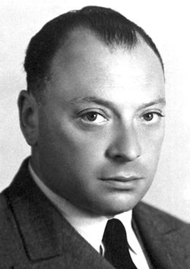
In 1930, Wolfgang Pauli proposed that another particle (a neutral particle, a particle that can not be detected) is emitted along with the electron.
However, Pauli was skeptical about the proposal.
In fact, on Dec. 4, 1930, Pauli wrote a letter to a conference organizer proposing the ideal of a neutral particle. Instead of attending the conference, he decided to go to a DANCE.

Slide 24
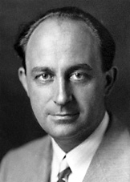
Enrico Fermi brought the particle into reality.
Fermi’s theory showed that the neutron (also bound in the nucleus) decays into a proton and simultaneously emits an electron and a neutrino.
The WEAK FORCE turns the neutron into a proton.
Fermi’s theory is called the “four-point beta decay”.
proton
neutron
electron
neutrino

Slide 25
Back to the Beta Decay
Measured Energy Spectrum of the Beta Particle
Number of events
Beta particle energy ( MeV)
3.169 MeV
Palladium
Electron (Beta Particle)
Neutrino
Rhodium
Energy is shared between the particles.

Slide 26
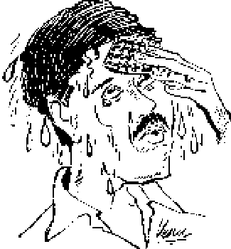
Fermi’s theory of energy remains conserved.
A new particle, the neutrino, is proposed.
Next step is to detect the neutrino.

Slide 27
Finding the Neutrino

Slide 28


Nature has many symmetries

Slide 29
Symmetry Plays a Fundamental Role in Particle Physics
Time Reversal
Any particle interaction that occurs forward in time can also occur backwards.
electron
electron (+), which is named the positron
neutron
neutrino
proton
neutrino
proton
Beta-Decay
neutron
Inverse Beta-Decay
We can DETECT the neutrino by the inverse beta-decay.

Slide 30
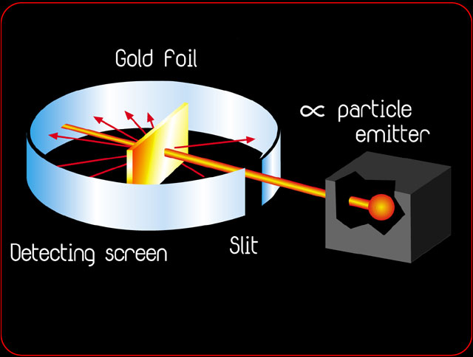
Physicists Use Scattering Experiments to Understand and Discover Particles
Scattering experiments measure the cross-section of a particle interaction.
Cross-section is the number of counts in which the particle interacts with another particle.

Slide 31
positron
To observe the neutrino, scientists needed to detect the signatures of the positron and neutron.
neutrino
proton
neutron
is a positive charged electron → interacts via the electromagnetic force → interaction results in emission of gamma rays
e⁺
positron
n⁰
looking inside the neutron
is an uncharged nucleon
neutron
an atomic nucleus can capture a neutron → strong force binds the neutron in the nucleus to create a heavier particle → the heavier particle is unstable → emits gamma rays to become stable
d
u
d

Slide 32
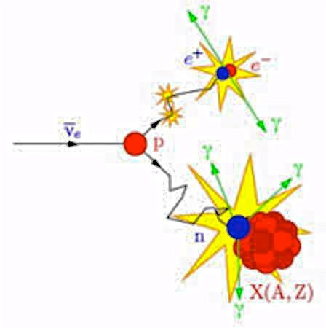
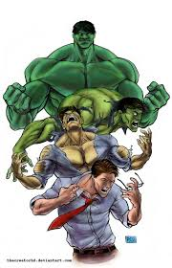
positron
signature of the inverse beta decay
neutrino
proton
Gamma Rays
neutron
The HULK is unstable.
Bruce Banner is stable.

Slide 33
One would think that finding the signature of the neutrino will be easy.
Physicists calculated the cross-section of the inverse beta-decay to be less than 10⁻⁴⁴ meters x meters.
What does that mean? What is the rate?
Image from B. Fleming
Neutrinos
Neutrinos produce from the Sun can travel up to 200 earths before interacting!!!

Slide 34
Neutrino interactions are extremely rare !
Need a high energy source of neutrinos!

Slide 35
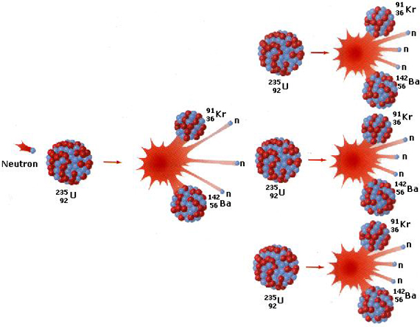
In 1934, Fermi was developing nuclear fission, artificial radioactivity. He bombarded heavy elements with slow neutrons.

Slide 36
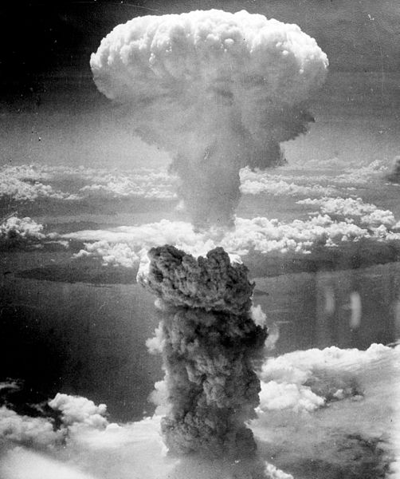
Fermi’s colleague Leo Szilard understood the military application of nuclear fission.
Both Fermi and Szilard recruited Albert Einstein to write a letter to President Franklin D. Roosevelt to encourage him to fund their work.
The Manhattan Project was put into action in 1942.
The most brilliant physicists of the era working together constructed the first atomic bomb!

Slide 37
After World War II, scientists aim to extend the knowledge of frontier particle physics.
From the explosion products of the nuclear bomb, scientists were given a manufactured nuclear reactor.
Lets do some Science!!!
Neutrons are unstable particles.
Neutrons decay via beta decay.
Beta decay is the emission of an electron and neutrino.
Nuclear reactors were expected to produce neutrino beams on the order of 10¹²-10¹³ neutrino / sec / cm² .

Slide 38
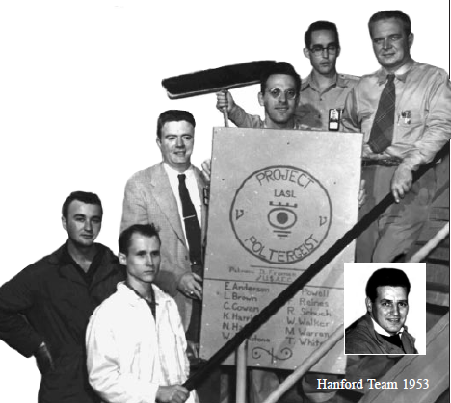
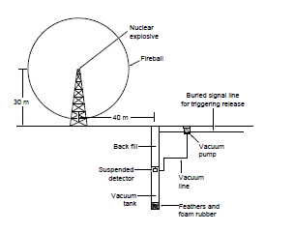
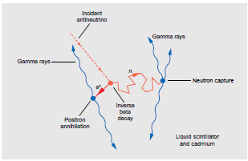
Project Poltergeist
Two decades later, a team lead by Clyde L. Cowan and Frederick Reines designed an experiment to detect the neutrino.
Uses neutrinos from nuclear fission.
Detector is filled with liquid scintillator.
Detects the outgoing particles from the neutrino interaction.
Results (1956)
  Neutrinos are observed at a rate of 0.56 counts per hour!
  Scientists did not measured the mass of the neutrino!

Slide 39
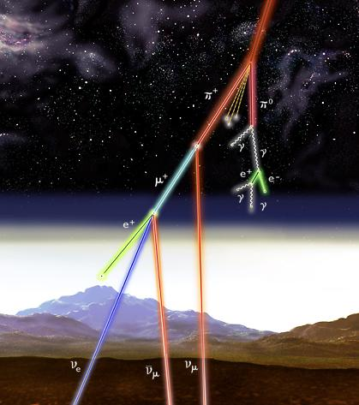
What about using neutrinos emitted from the Sun to measure the mass of the neutrinos?
Solar neutrinos are given to us for free!
We should take advantage of them.
And maybe learn a thing or two about the universe!

Slide 40
First of all, I am glad you are paying attention ☺ !
In the late 1930s, physicists developed the solar model.
The solar model mathematically describes the nuclear fusion reactions that are occurring in the Sun’s core.

Slide 41
30 years after Project Poltergeist

Slide 42
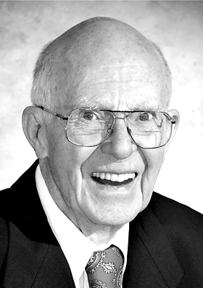
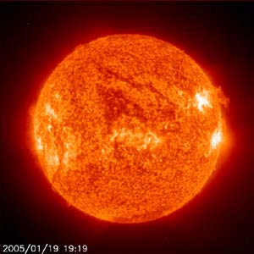
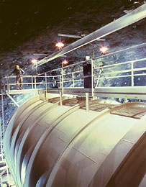
In 1961, Ray Davis confirmed the detection of solar neutrinos. The Homestake Experiment used solar neutrino interactions to convert Chlorine-37 into radioactive Argon-37.
After correcting for detector effects and using the Solar Model prediction, the Davis’ group expected to see one solar neutrino per day.
However, they only saw one solar neutrino every fourth day.
Where do all of the neutrinos go?
ν_{e}
ν_{e}
ν_{e}
ν_{e}
ν_{e}
ν_{e}
ν_{e}
ν_{e}
ν_{e}
ν_{e}
ν_{e}
ν_{e}
ν_{e}
ν_{e}
ν_{e}
ν_{e}
ν_{e}
ν_{e}
ν_{e}
ν_{e}
ν_{e}
ν_{e}
ν_{e}
ν_{e}
ν_{e}
ν_{e}
ν_{e}
ν_{e}
ν_{e}
ν_{e}
ν_{e}
ν_{e}
ν_{e}
ν_{e}
Homestake Mine
Lead, SD, USA

Slide 43
But first, lets go back to the 1930s

Slide 44
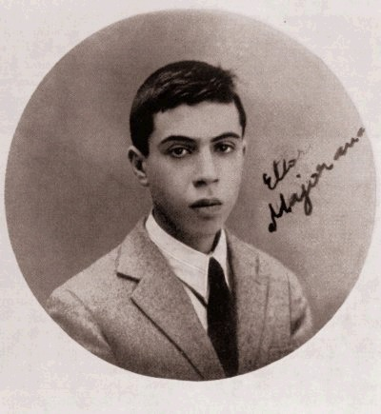

After Fermi published his beta-decay theory, Ettore Majorana derived a theory to suggest that the neutrino may be its own anti-particle. Means that the neutrino and anti-neutrino are the same.
Neutrinos may have a non-zero mass.

Slide 45
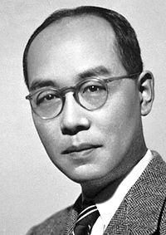
In 1936, Yukawa proposed the W boson.
The carrier of the WEAK FORCE.
The weak force is one of the four fundamental forces of nature.
Weak force is 10,000 times weaker than the electromagnetic force.
neutron
proton
W⁻
electron
neutrino

Slide 46
Recap
Fundamental Forces of the Universe
Gravitational Force
Electromagnetic Force
Strong Nuclear Force
Weak Nuclear Force

Slide 47
What have we learn thus far about neutrinos?
Neutrinos maybe massless.
The expected number of solar neutrinos is missing.
Neutrinos do not have charge!
Neutrinos only interact by the weak force.
Neutrinos are difficult to detect!

Slide 48
The Mysteries of Neutrinos

Slide 49


NEUTRINO EXPERIMENTS
NEUTRINO THEORIES

Slide 50
Do neutrinos have mass?
Where are the missing neutrinos produce from the Sun?

Slide 51
The muon was discovered before the neutrino.
π → μ ν
Recall that the muon is a 2nd generation of the electron.
There must be a 2nd generation of the neutrino.
Eventually, physicists discovered that there exist two types of neutrinos.
So….., how many generations of neutrinos do exist?
e
μ
νe
νμ

Slide 52
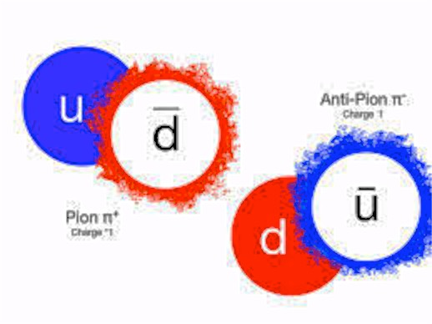
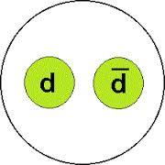
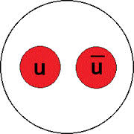
What is a Pion (π)?
A particle made from a quark and anti-quark pair.
There are three types of pions.
π
π⁻
π⁰
π⁺

Slide 53
The muon was discovered before the neutrino.
π → μ ν
Recall that the muon is the 2nd generation of the electron.
There must be a 2nd generation of the neutrino.
Eventually, physicists discovered that there exist two type of neutrinos.
So….., how many generations of neutrinos do exist?
e
μ
νe
νμ

Slide 54
Physicists worried about the number of generations.
Both particle and astro-physicists work towards measuring the number of generations.
From cosmology → Studied the concentration of ⁴He and H in the gas clouds surrounding galaxies → Calculated that there cannot be more than 5 generations → measured 3 generations
Just pretend you are an expert on this particle ☺
From particle physics → Studied the decay of Z⁰ boson → measured 3 generations

Slide 55
Recap: Leptons
Discovered in the mid 1970s at Fermilab
e
μ
τ
electron
muon
tau
ν_{e}
ν_{μ}
ν_{τ}
electron
neutrino
muon
neutrino
tau
neutrino
Discovered in 2000

Slide 56
e
μ
τ
νe
νμ
ντ
Particle physics proposed that the measured neutrinos are NOT REAL particles!
In fact, the real neutrinos ν₁, ν₂, ν₃ mix to create the flavor neutrinos, ν_{e}, ν_{μ}, ν_{τ} !
The real neutrinos, ν₁, ν₂, ν₃ have a well defined mass.

Slide 57

Wait….
So, the neutrinos that scientists have detected are a mixture of real neutrinos?

Slide 58
Neutrino Oscillations
  Neutrinos create with a specific flavor can evolve into a different flavor at a later time.
Diagram shows the probability of changing to another type of neutrino as a function of time.
ν_{e}
ν_{μ}
ν_{e}
ν_{e}
ν_{μ}
ν_{μ}
ν_{μ}
ν_{e}
ν_{e}
ν_{e}
ν_{e}
ν_{e}
ν_{e}
ν_{e}
ν_{μ}
ν_{μ}
ν_{μ}
ν_{e}
ν_{e}
ν_{e}
ν_{e}
ν_{e}
ν_{e}
ν_{e}
ν_{e}
ν_{e}
ν_{e}
ν_{μ}
ν_{μ}
ν_{e}
ν_{e}
ν_{e}
ν_{μ}
ν_{e}
ν_{e}
ν_{e}
ν_{e}
ν_{e}
ν_{e}
ν_{μ}
ν_{e}
ν_{e}
ν_{μ}
ν_{μ}
ν_{μ}
ν_{e}
ν_{e}
ν_{e}
ν_{e}
ν_{μ}
ν_{e}
ν_{e}
ν_{e}
ν_{e}
ν_{e}
ν_{e}
ν_{e}
ν_{e}
ν_{μ}
ν_{e}
ν_{e}
ν_{μ}
ν_{μ}
time

Slide 59

So if the neutrino can change into another type of neutrino… Does that mean that neutrinos have mass?!
Yes by theory, but first we have to search for neutrino oscillations.
Where..?
As I understand, you need an intense source of a neutrino beam and a very LARGE distance between detectors to observe neutrinos oscillate.

Slide 60
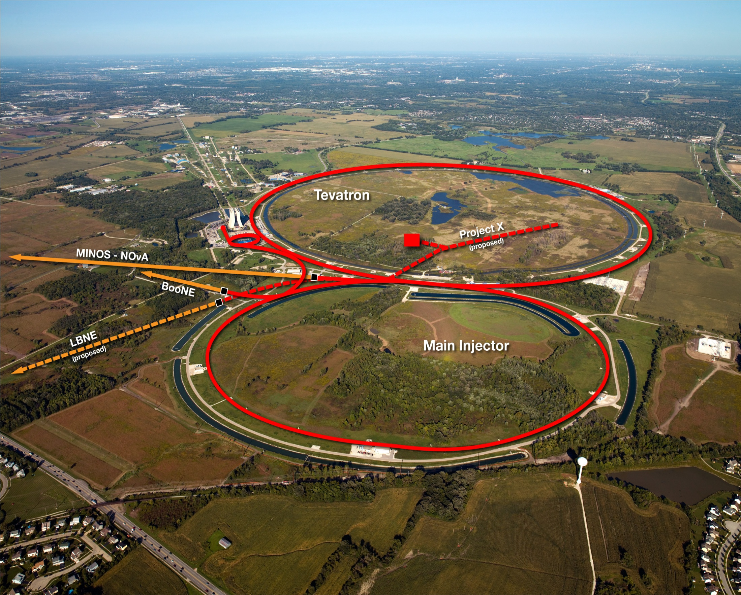
Right here in the United States, at Batavia, IL:
Fermilab

Slide 61
Understanding the Behaviors of Neutrinos

Slide 62
muons
target
Beam of protons
pions
neutrinos
Carbon
pion
muon
proton
W
neutrino
particles

Slide 63
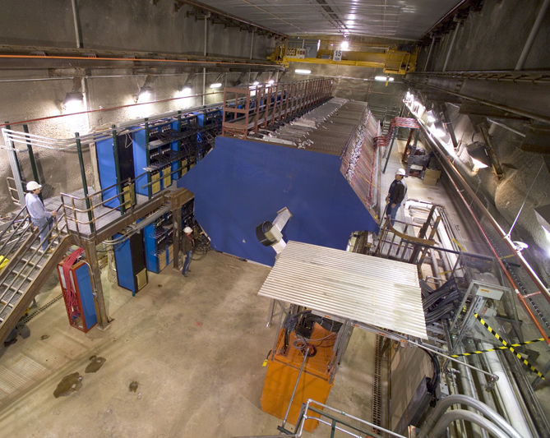
Front View of the MINOS Near Detector
The detector records information about the particles from neutrino interactions.
ν_{μ}
100 meters underground
ν_{μ}
ν_{μ}
ν_{μ}
ν_{μ}
ν_{μ}
ν_{μ}
ν_{μ}
ν_{μ}
ν_{μ}
ν_{μ}

Slide 64
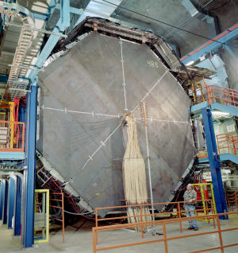
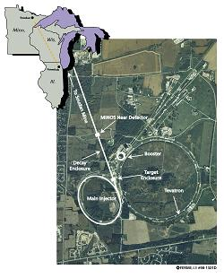
Front View of the MINOS Far Detector
716 meters underground
ν_{μ}
ν_{τ}
735 km (450 miles)
Soudan, MN
Batavia, IL

Slide 65
Back in 1998

Slide 66
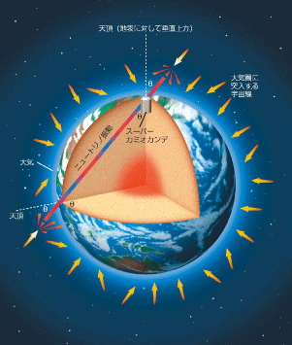
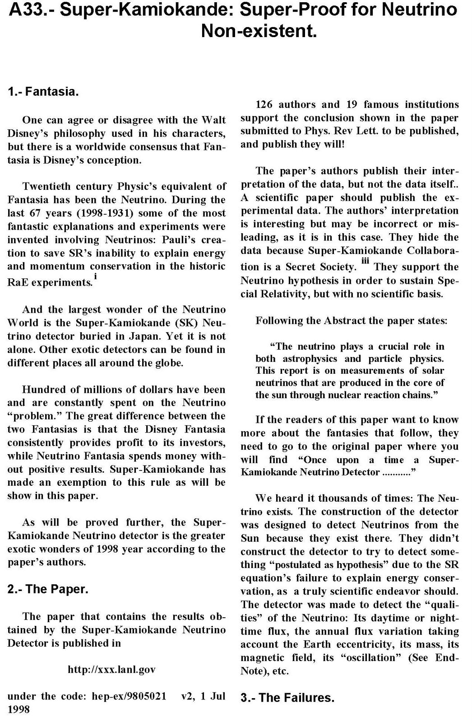
Super–Kamiokande (Super K is located in Japan) announced the finding of neutrinos with non-zero mass.
Study neutrino oscillations using atomspheric neutrinos.
Atomspheric neutrinos produce by the decay of particles resulting from interaction of particles with the Earth’s atmosphere.

Slide 67

excerpted from remarks at the MIT commencement, June 6, 1998
This discovery was made, in Japan, yes, but it had the support of the investment of the U.S. Department of Energy. This discovery calls into question the decision made in Washington a couple of years ago to disband the Super-conducting Supercollider, and it reaffirms the importance of the work now being done at the Fermi National Acceleration Facility in Illinois.
Former President Bill Clinton

Slide 68
What is the Source of the Missing Solar Neutrinos?
e
μ
τ
νe
νμ
ντ
Can neutrino oscillations explain the missing solar neutrinos?
By the time the neutrinos enter the Earth’s atmosphere, the electron neutrinos COULD BE changing flavour.

Slide 69
Solving a 40-year Puzzle

Slide 70
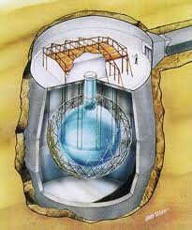
In 2001, the results from Sudbury Neutrino Observatory (SNO) in Canada solved the mystery of the missing solar neutrinos puzzle.
SNO announced that the total number of all neutrino flavour agrees with the Solar model.
Awesome, this means that scientists do have some understanding of the Sun!

Slide 71
RECAP
Scientists were able to characterize some of the properties of the neutrino.
  Three generations of neutrinos.
  The flavour neutrinos are mixture of the real neutrinos.
  Neutrinos have mass.
  Neutrinos have a small mass.
  Neutrinos oscillate.
  ….

Slide 72
Why is it important for physicists to build more large detectors to understand neutrinos?

Slide 73
Neutrinos have mass.
BUT.. Why are the neutrinos SO FREAKING light?
There is a very popular theory floating around.
BUT REALLY…
We do NOT know!

Slide 74
Neutrinos have mass.
The picture of the standard model is not completely correct.
This is evidence that there are MANY behaviors in nature that we do not understand.

Slide 75

Wait….
So, the neutrinos that scientists have detected are a mixture of real particles?
All we know is the difference between the masses.
We do not know if the real neutrino ν₃ consists of more ν_{μ} or ν_{τ}.
In fact, ν₁, ν₂, or ν₃ can consist of more than 3 flavours of neutrinos.
Do not know the ordering of the masses?

Slide 76
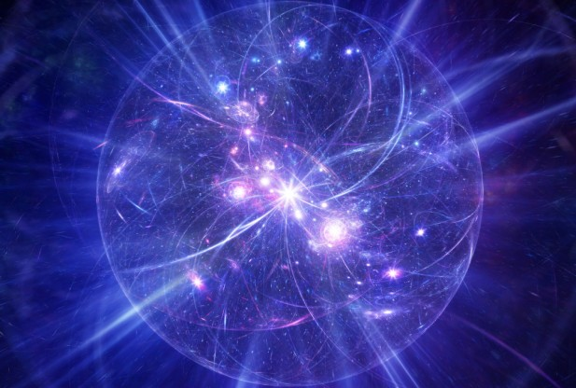
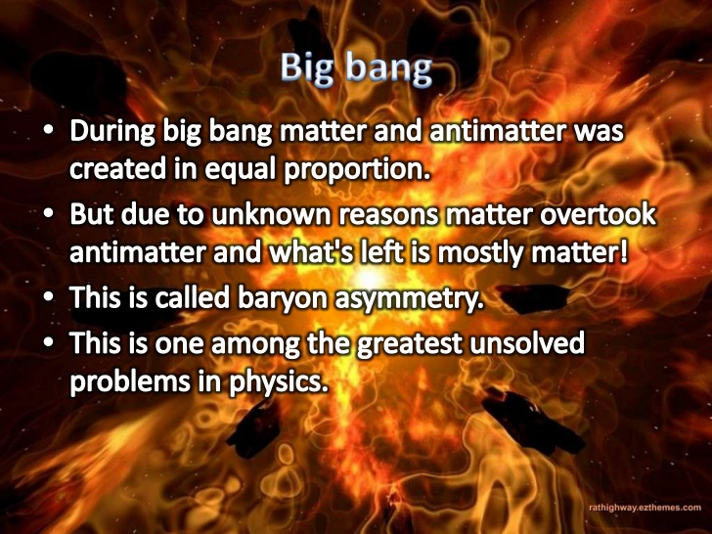
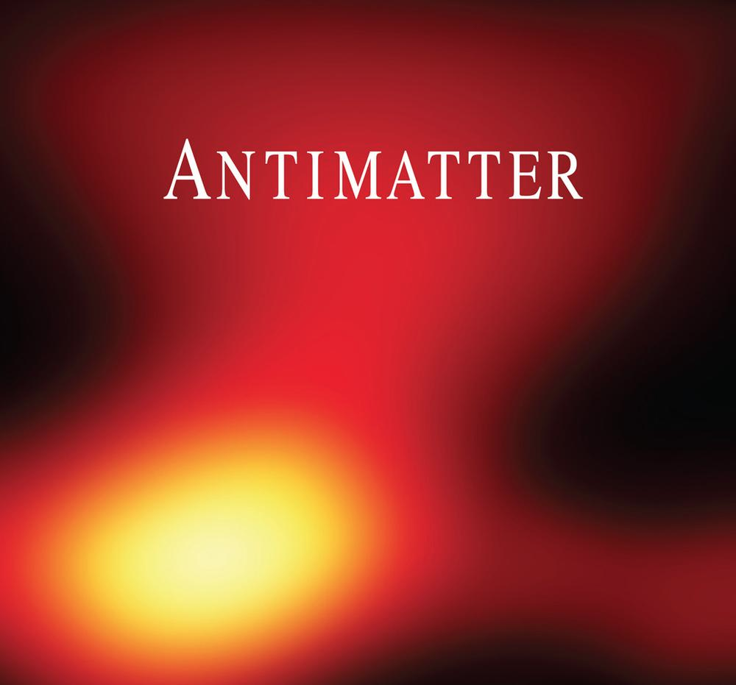
Remember THIS Guy!
He predicted that the neutrino and anti-neutrino are exactly the same.
This is important because …
Big Bang created equal amount of matter and anti-matter.

Slide 77
Remember THIS Guy!
He predicted that the neutrino and anti-neutrino are exactly the same.
Making precision measurements of the properties of neutrinos bring us a step closer to uncovering the biggest mysteries of the universe!
Enter the new ERA of Neutrino Detectors

Slide 78
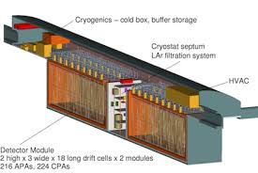
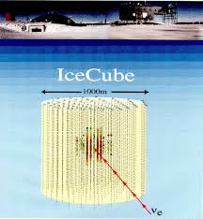
NOvA Experiment

Slide 79
Recap
Theoretical predications are faster than experimental developments.
Current measurements of the fundamental properties of neutrinos show that we do not fully understand the universe.
There exists new detector technology to answer many of the unknown questions.

Slide 80
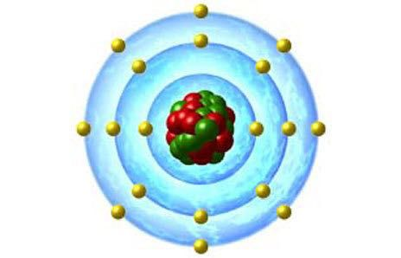
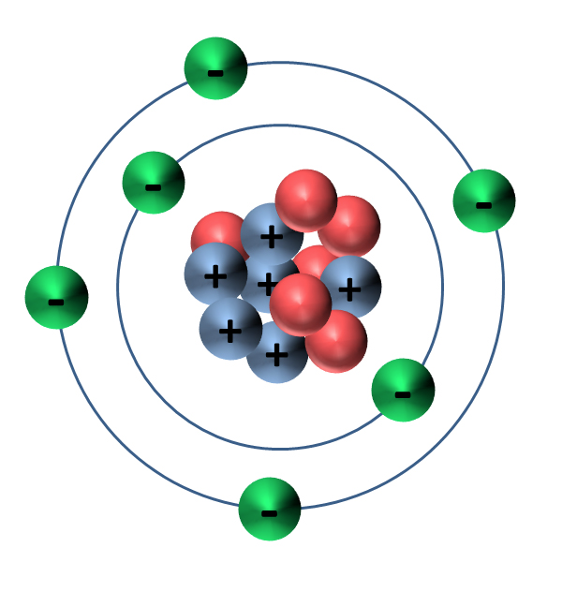
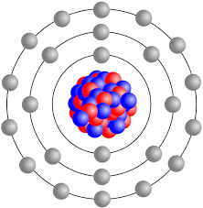
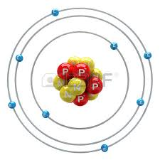
The rate of neutrino interactions is SO small.
Therefore, large detectors composed of heavy atoms are needed.
Argon
Carbon
Iron
Oxygen

Slide 81

with new technology comes new challenges
The Future of Neutrinos: DUNE
Deep Underground Neutrino Experiment

Slide 82
What do neutrino physicists want?
charged lepton
neutrino
nucleon
nucleon
Easy to calculate ☺

Slide 83

What do neutrino physicists have?
charged lepton
neutrino
also known as hadrons
nucleus
nucleon
many nucleons
nucleon and pions
nucleon and many pions
nucleon and many other type of particles
nothing
Very difficult to calculate ☹

Slide 84



Why is it so complicated?
The neutrino has to collide with a nucleon under various scenarios.....
The environment of the nucleus is a BEAST!
Also, there is a pion cloud surrounding the nucleus.
The inside of a nucleon really looks like this!!!
3 valence quarks, sea of quarks, and particles called gluons holding them together.
nucleon bound with another nucleon

Slide 85
An Example of a Neutrino Interaction
ν_{μ}
μ⁻
W
π⁺
Δ⁺⁺
p

Slide 86
Why is it so complicated?
The outgoing hadrons have to exit this complicated environment.
On the way out of the nucleus, the hadron can undergo various interactions with spectator nucleons.
The detector will see many, one, or no hadrons.

Slide 87
Around the world and at Fermilab, there are experiments dedicate to measuring the rate of neutrino interactions.
The experiments are composed of different type of materials.
This allows precision measurements of neutrino interactions for various materials.
If we do not understand how neutrinos interact in matter, we will not be able to measure the properties of neutrinos!

Slide 88





ArgoNeuT
MINERνA
T2K
MiniBooNE

Slide 89




What do the detectors see?

Slide 90
Outlook

Slide 91


Nobel Prize in 2015 for Discovering Neutrino Oscillations

Slide 92

Neutrinos have Mass!
New Physics
Neutrino-Standard Model of Elementary Particles

Slide 93
Why are Neutrinos SO special?

Slide 94

Thank you for your Attention!
ν_{μ}
ν_{μ}
ν_{μ}
ν_{μ}
ν_{μ}
ν_{μ}
ν_{μ}
ν_{μ}
ν_{μ}
ν_{μ}
ν_{μ}
ν_{μ}
ν_{μ}
ν_{μ}
ν_{μ}
ν_{μ}
ν_{μ}
ν_{μ}
ν_{μ}
ν_{μ}
ν_{μ}
ν_{μ}
ν_{μ}
ν_{μ}
ν_{μ}
ν_{μ}
ν_{μ}
ν_{μ}
ν_{μ}
ν_{μ}
ν_{μ}
ν_{μ}
ν_{μ}
ν_{μ}
ν_{μ}
ν_{μ}
ν_{μ}
ν_{μ}
ν_{μ}
ν_{μ}
ν_{μ}
ν_{μ}
ν_{μ}
ν_{μ}
ν_{μ}
ν_{μ}
ν_{μ}
ν_{μ}
ν_{μ}
ν_{μ}
ν_{μ}
ν_{μ}
ν_{μ}
ν_{μ}
ν_{μ}
ν_{μ}
ν_{μ}
ν_{μ}
ν_{μ}
ν_{μ}
ν_{μ}
ν_{μ}
ν_{μ}
ν_{μ}
ν_{μ}
ν_{μ}
ν_{μ}
ν_{μ}
ν_{μ}
ν_{μ}
ν_{μ}
ν_{μ}
ν_{μ}
ν_{μ}
ν_{μ}
ν_{μ}
ν_{μ}
ν_{μ}
ν_{μ}
ν_{μ}
ν_{μ}
ν_{μ}
ν_{μ}
ν_{μ}
ν_{μ}
ν_{μ}
ν_{μ}
ν_{μ}
ν_{μ}
ν_{μ}
ν_{μ}
ν_{μ}
ν_{μ}
ν_{μ}
Thank You
ν_{μ}
ν_{μ}
ν_{μ}
ν_{μ}
ν_{μ}
ν_{μ}
ν_{μ}
ν_{μ}
ν_{μ}
ν_{μ}
ν_{μ}
ν_{μ}
ν_{μ}
ν_{μ}
ν_{μ}
ν_{μ}
ν_{μ}
ν_{μ}
ν_{μ}
ν_{μ}
ν_{μ}
ν_{μ}
ν_{μ}
ν_{μ}
ν_{μ}
ν_{μ}
ν_{μ}
ν_{μ}
ν_{μ}
ν_{μ}
ν_{μ}
ν_{μ}
ν_{μ}
ν_{μ}
ν_{μ}
ν_{μ}
ν_{μ}
ν_{μ}
ν_{μ}
ν_{μ}
ν_{μ}
ν_{μ}
ν_{μ}
ν_{μ}
ν_{μ}
ν_{μ}
ν_{μ}
ν_{μ}
ν_{μ}
ν_{μ}
ν_{μ}
ν_{μ}
ν_{μ}
ν_{μ}
ν_{μ}
ν_{μ}
ν_{μ}
ν_{μ}
ν_{μ}
ν_{μ}

